Slide 1

DemoWebshop
Manual Testing to follow Agile practices and design and execute Test Cases and create Defect Report
Team Members :
Raghav Khanna
Rakkesh R
Ramya G
Ramya Bharathi Thupakula
Samudrala Lakshmi Durga Bhavnai

Slide 2

Index
Project Description
Roles and responsibilities
Sprint plan
User Stories
Requirements
Test cases
Defects
Traceability Matrix
Summary Report
Challenges Faced

Slide 3

Demo web shop is the sample online application for buying items It supports various functionalities such as user registration, login, searching for a product, add items to cart and payments. It is developed by Tricentis. It supports multiple browsers such as IE, Firefox, Chrome.
Project Descriptions
Modules to be tested
Registration Module
Login module
Search Module
Product Module
Receipt Module

Slide 4




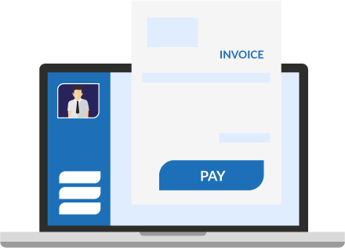
Roles of Teams Members:
Search Module
Handled by :
Ramya Bharathi Thupakula
Login Module
Handled by :
Rakkesh R
Registration Module
Handled by :
Samudrala Lakshmi
Durga Bhavnai
Receipt Module
Handled by :
Raghav Khanna
Product Module
Handled by :
Ramya G

Slide 5

Sprint Plan
As a Team we started the sprint from 24/06/22.
Sprint Plan:
Day 1:
Create Task / Deliverables:
1. List of User Stories & Functions to test
2. All tasks with JIRA should be ready in SCRUM template
Day 2:
Create Task / Deliverables:
1. Test scenarios
2. Test Case design
Day 3:
Create Task / Deliverables:
1. Test Case design
2. Test Case execution
Day 4:
Create Task / Deliverables:
1. Defect reporting
2. Traceability Matrix
3. Test summary report
Day 5: Sprint Evaluation

Slide 6
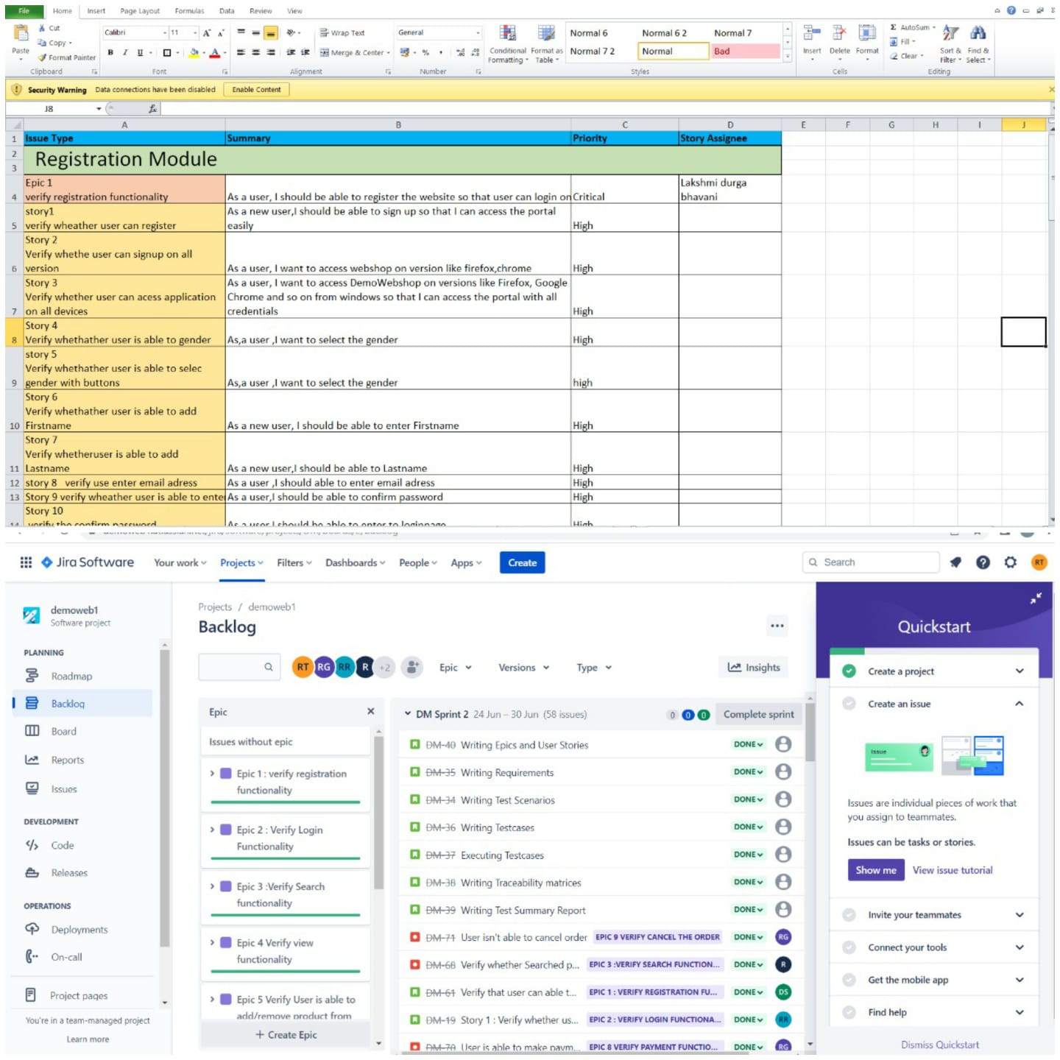
User Stories
A user story is a tool in Agile software development used to capture
a description of a software feature from a user's perspective.

Slide 7
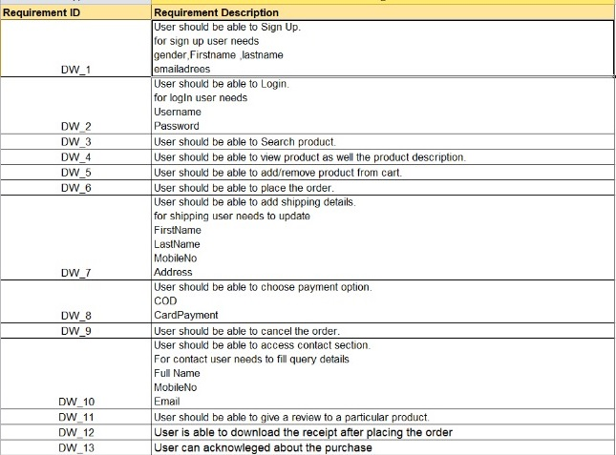

Requirements
Documents containing all relevant information about the application under test is known as requirement.
As a team we listed
down the following
Requirements to test
Various epics and their
User stories.

Slide 8
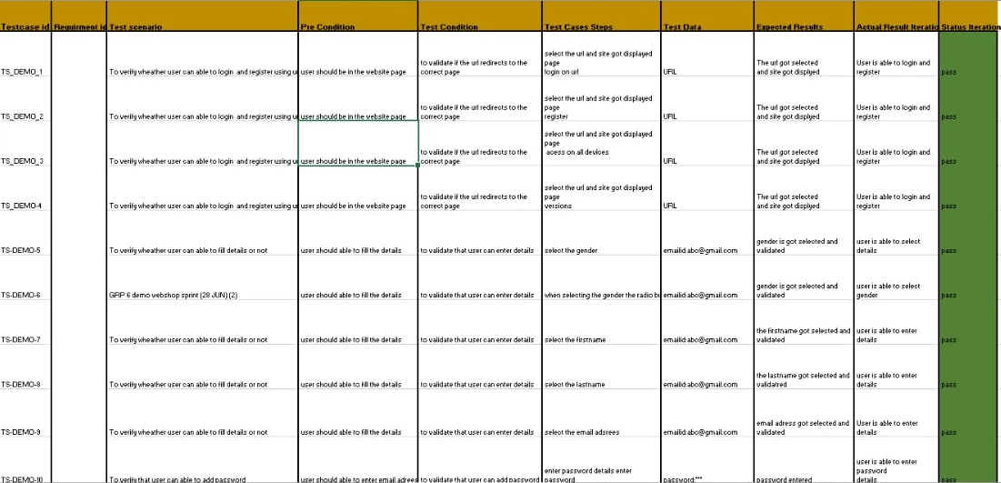
Test Cases
Test cases define how to test a system, software or an application.

Slide 9
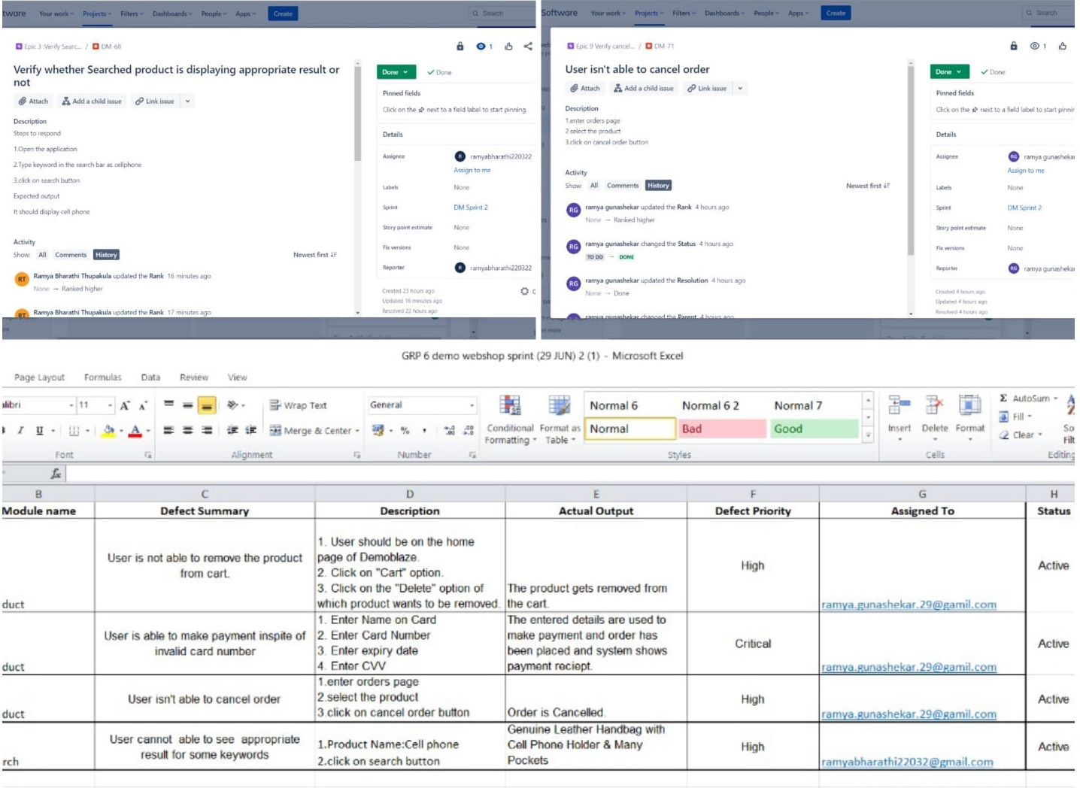
Defects
A defect is a system error that doesn't allow the intended action to be completed.

Slide 10
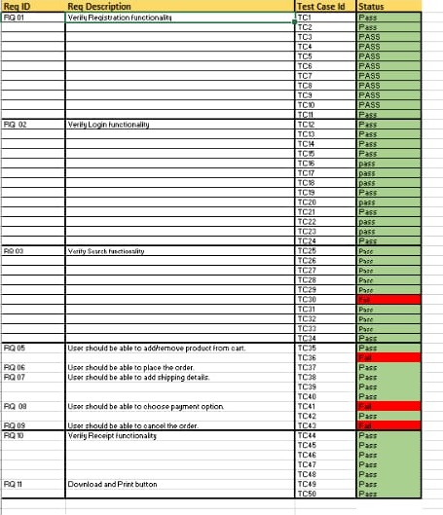

Traceability Matrix
A traceability matrix is a document that details the technical
requirements for a given test scenario and its current state

Slide 11
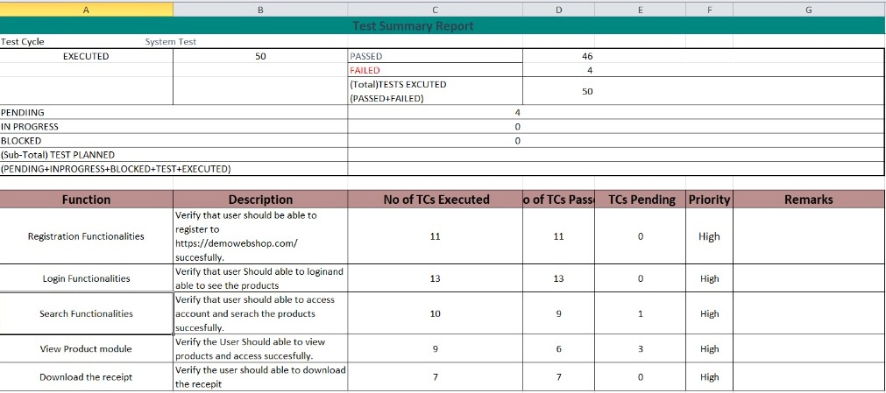

Summary Report
A test summary report is a Quality work product / Test Document that
formally summarizes the results of all testing.

Slide 12
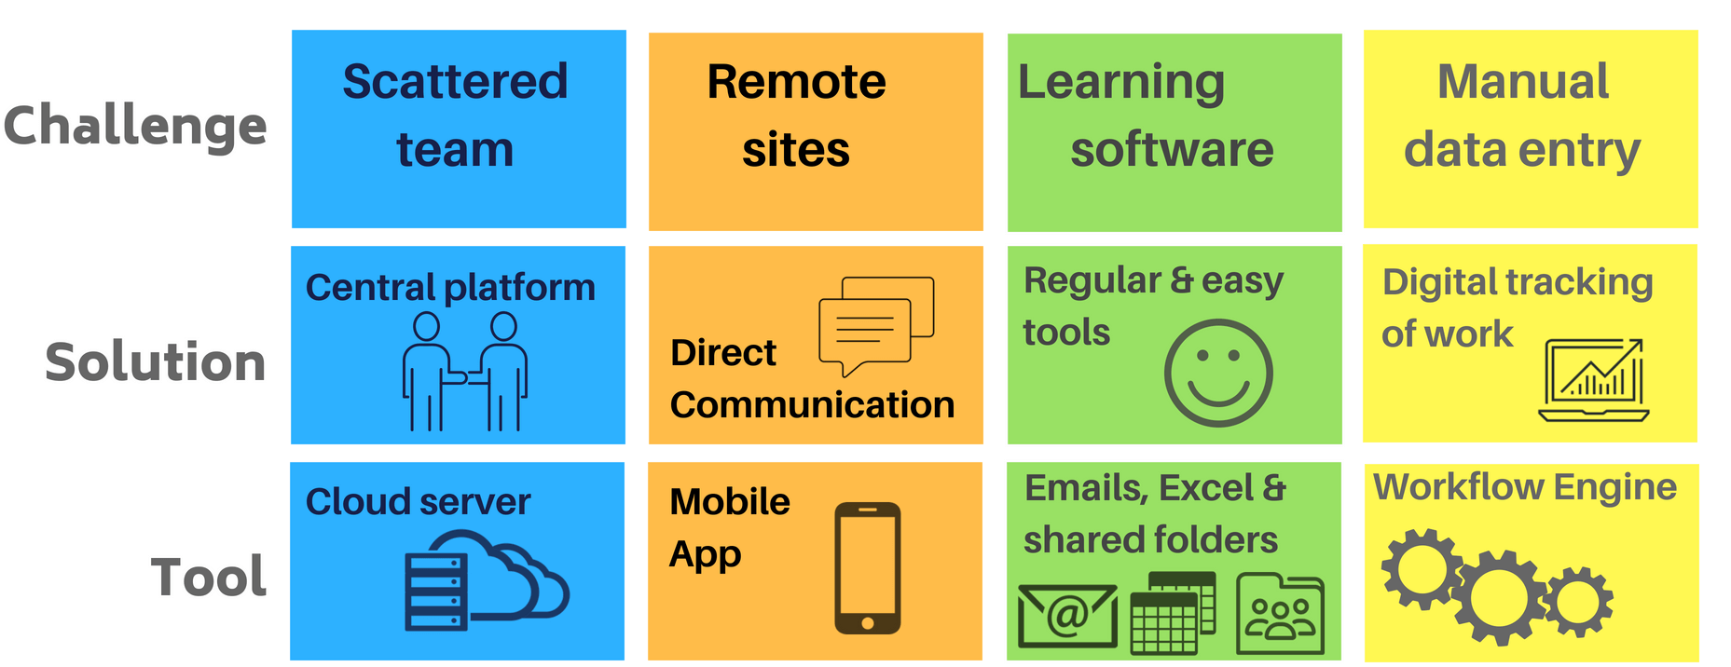
Challenges Faced

Slide 13


